Slide 1

National University of Computer and Emerging Sciences
Introduction to Diffusion Models
AI-5004 Adv. Topics in Generative AI
Dr. Muhammad Nouman Noor
Department of Artificial Intelligence and Data Science

Slide 2
Goals
Recap of Previous Lecture
Today’s Lecture
Introduction to Diffusion Models
Denoising Diffusion Models

Slide 3
Recap of Previous Lecture

Slide 4
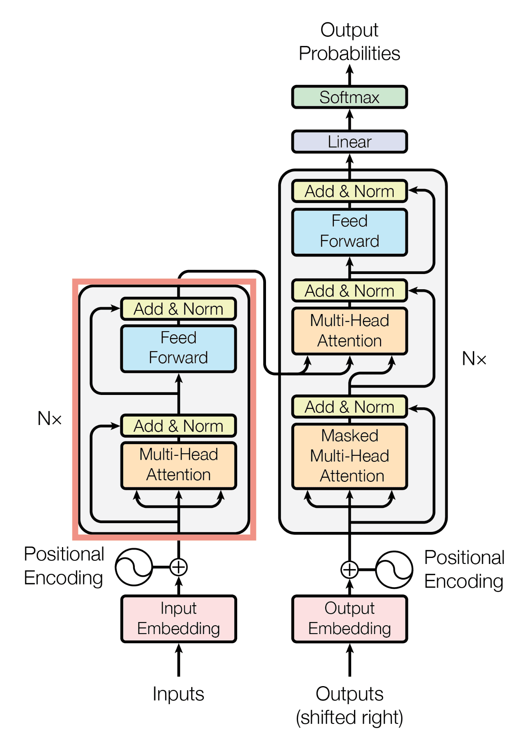
Transformer Model Architecture
The Transformer follows this overall architecture using stacked self-attention and point-wise, fully connected layers for both the encoder and decoder

Slide 5
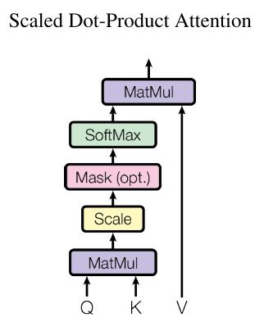
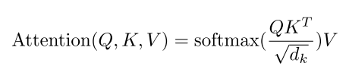
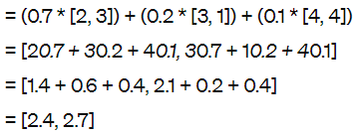
Scaled Dot-Product Attention
Generative AI Course
Weighted representation for “Generative":
This is just an illustration
Actual values will be calculated for Q and V and K as
Q = Wq * X, K = Wk * X, V = Wv * X

Slide 6
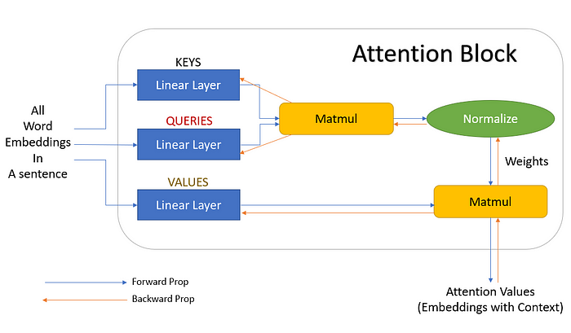
Scaled Dot-Product Attention
towardsdatascience.com

Slide 7
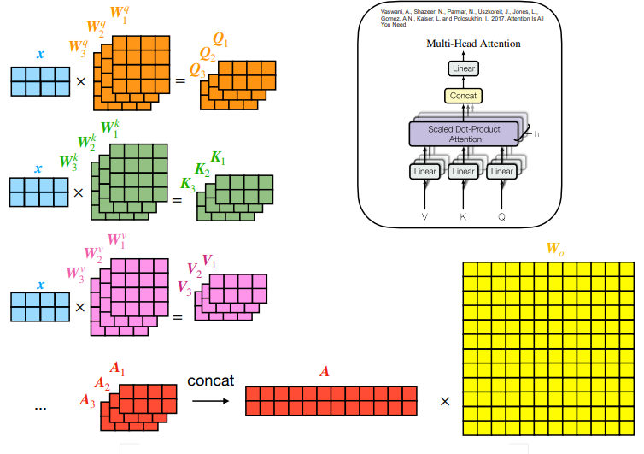
Multi-Head Attention
medium.com

Slide 8
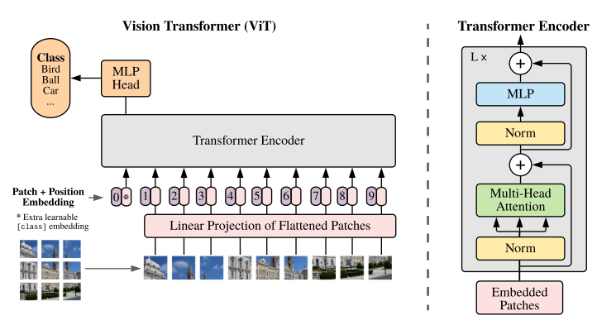
Vision Transformer (ViT)

Slide 9
Today’s Lecture

Slide 10
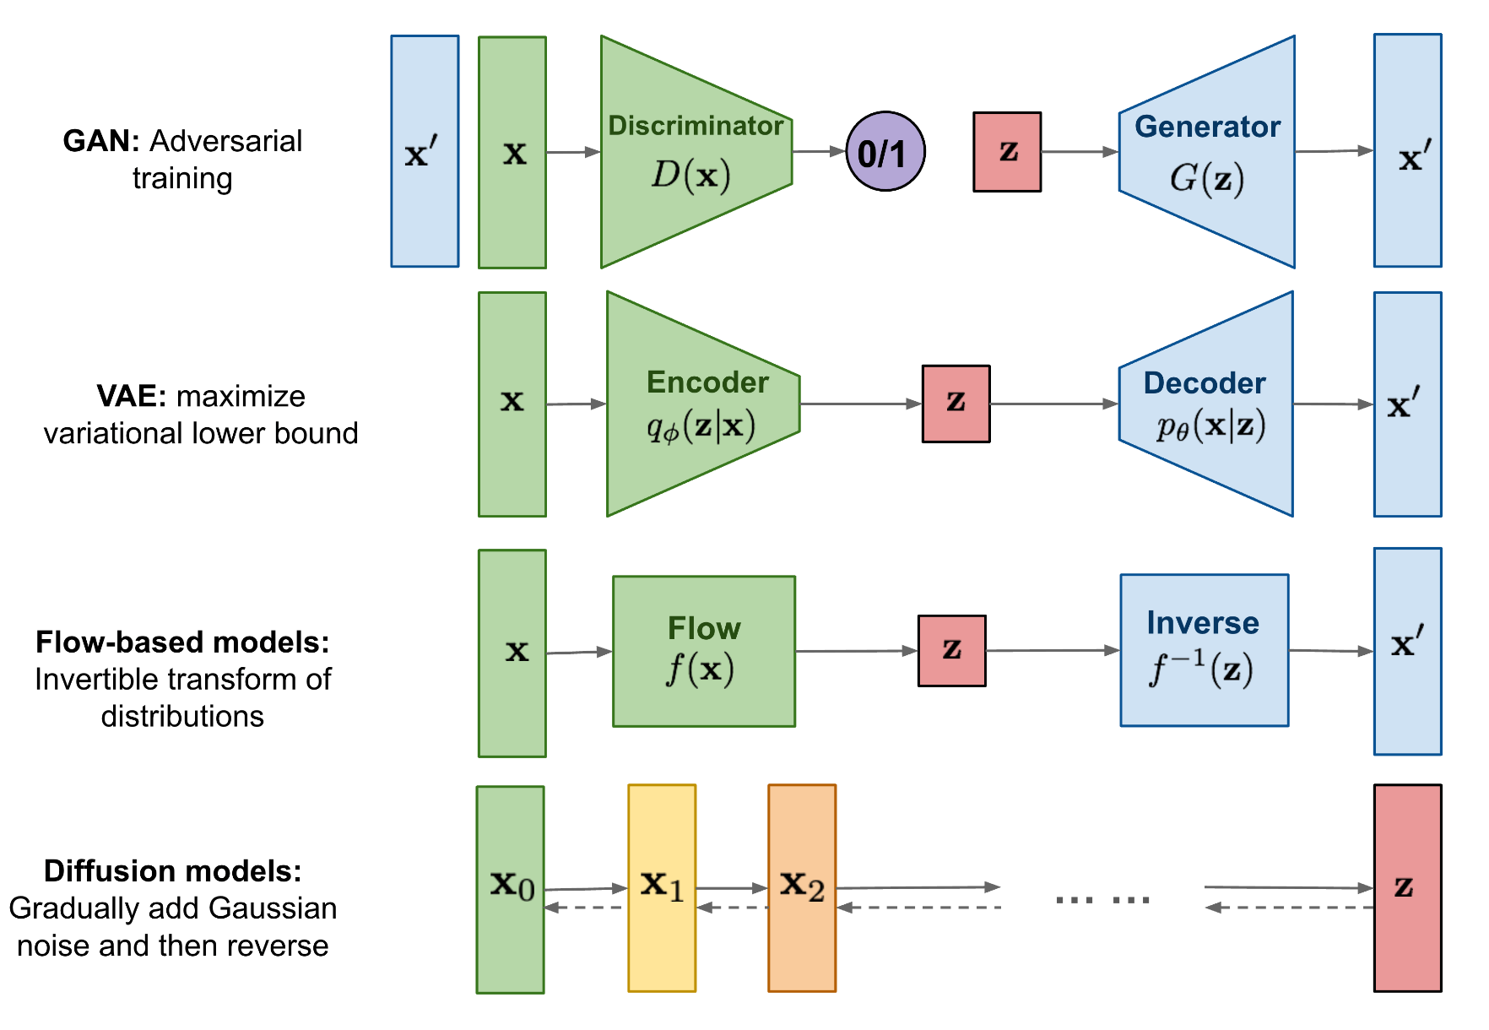
Deep Generative Models
lilianweng.github.io

Slide 11
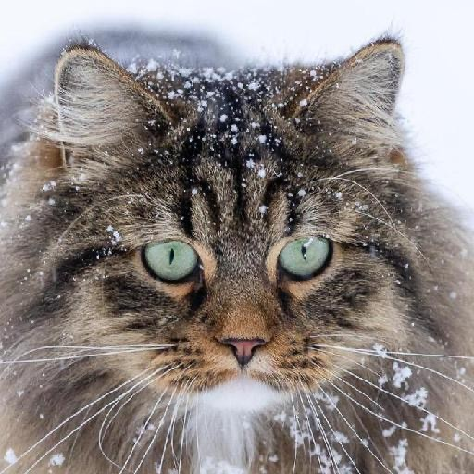
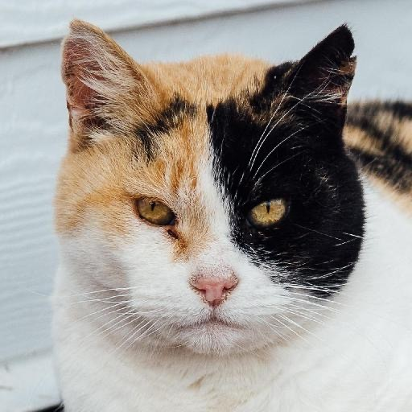
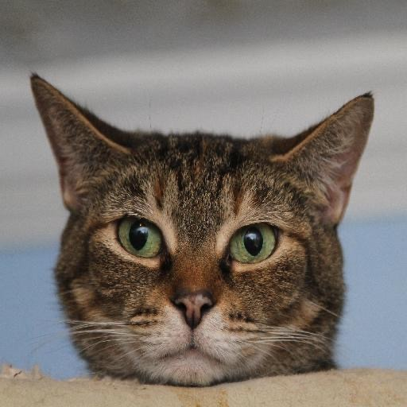
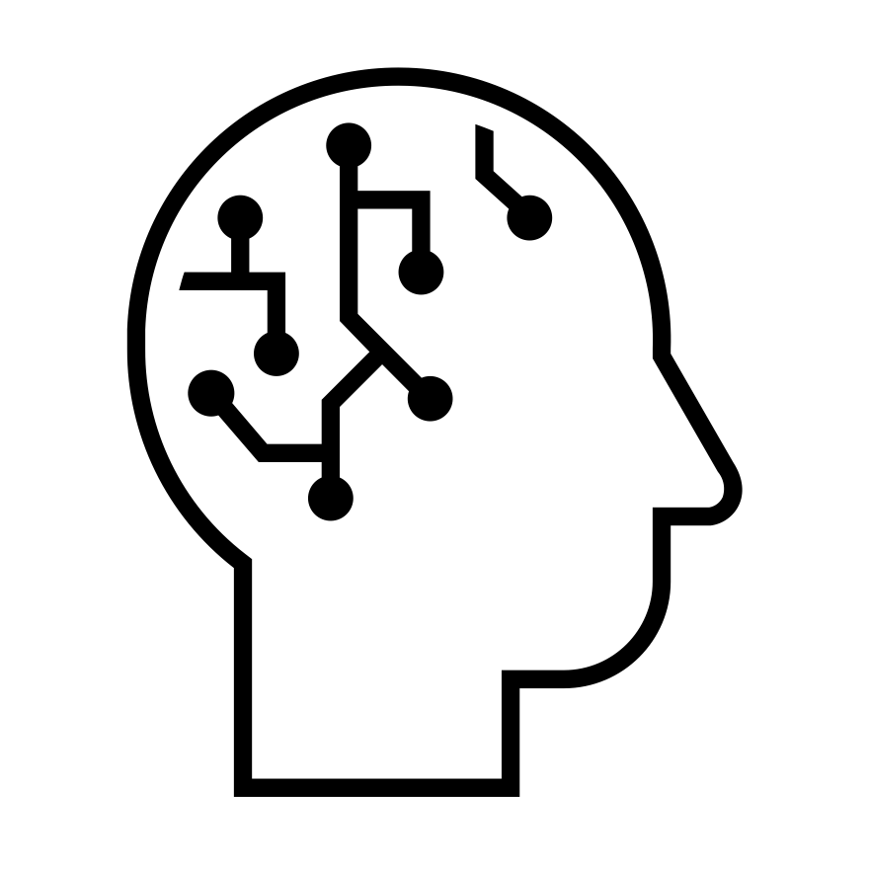
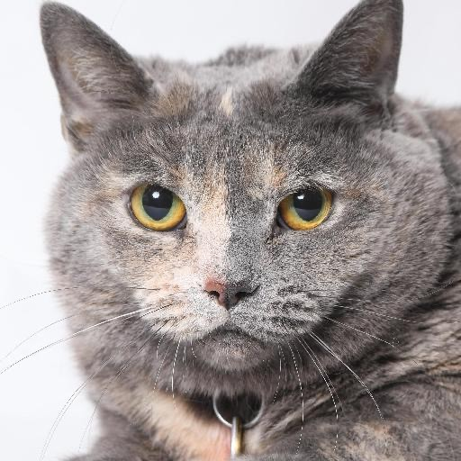
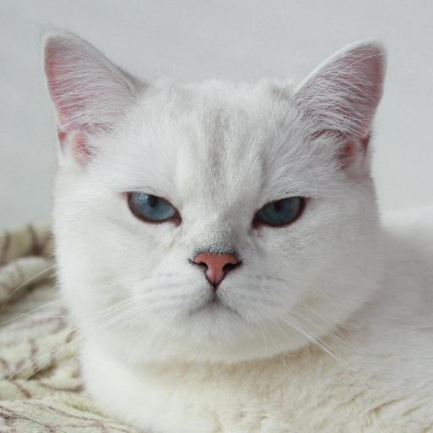
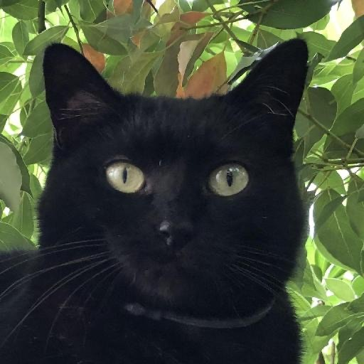
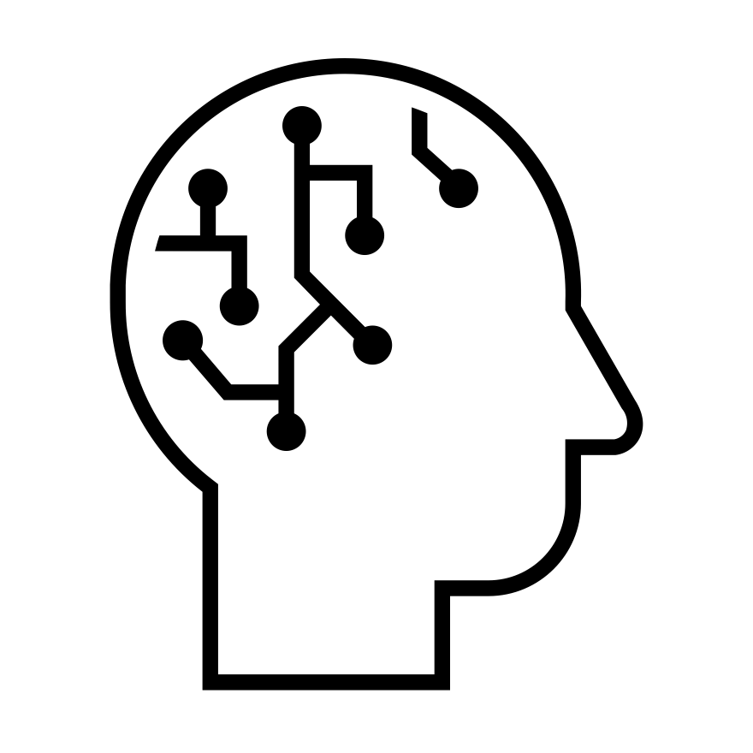
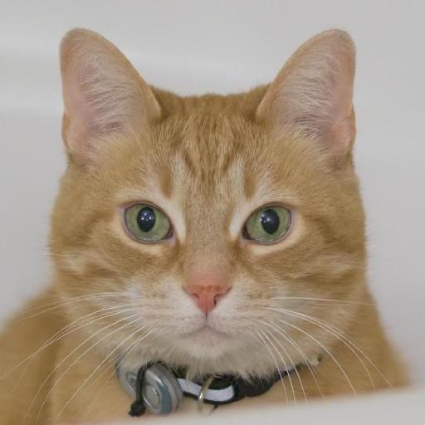
Deep Generative Learning
Learning to generate data
Train
Samples from a Data Distribution
Neural Network
Sample
2

Slide 12
The Landscape of Deep Generative Learning
Variational Autoencoders
Normalizing Flows
Autoregressive Models
Generative Adversarial Networks
Denoising Diffusion Models
Energy-based Models
7

Slide 13
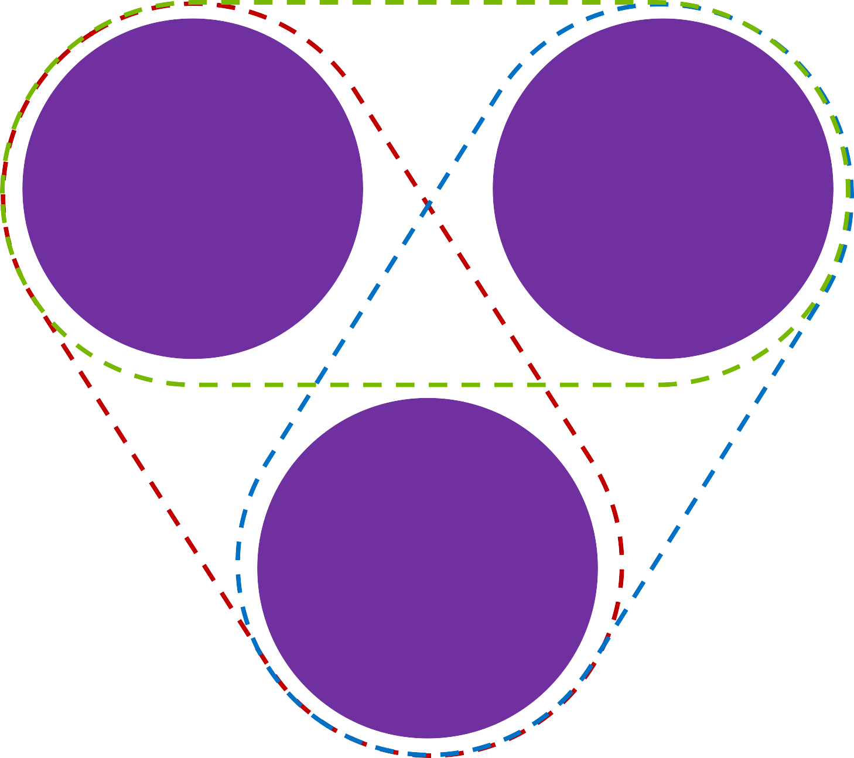
What makes a good generative model?
The generative learning trilemma
Likelihood-based models (Variational Autoencoders & Normalizing flows)
Fast Sampling
Mode Coverage/ Diversity
Generative Adversarial Networks (GANs)
Denoising Diffusion Models
High Quality Samples
Often requires 1000s of network evaluations!
Tackling the Generative Learning Trilemma with Denoising Diffusion GANs, ICLR 2022
79

Slide 14
Applications of Diffusion Models

Slide 15
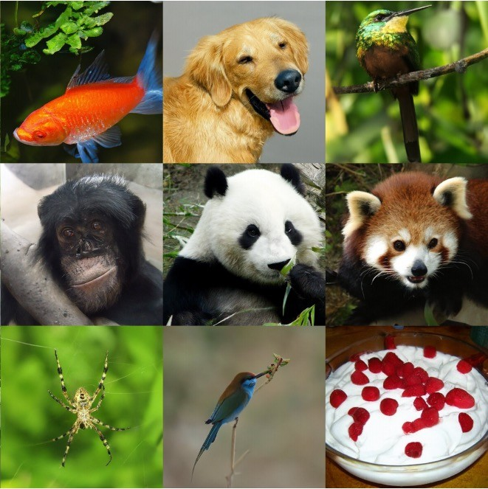
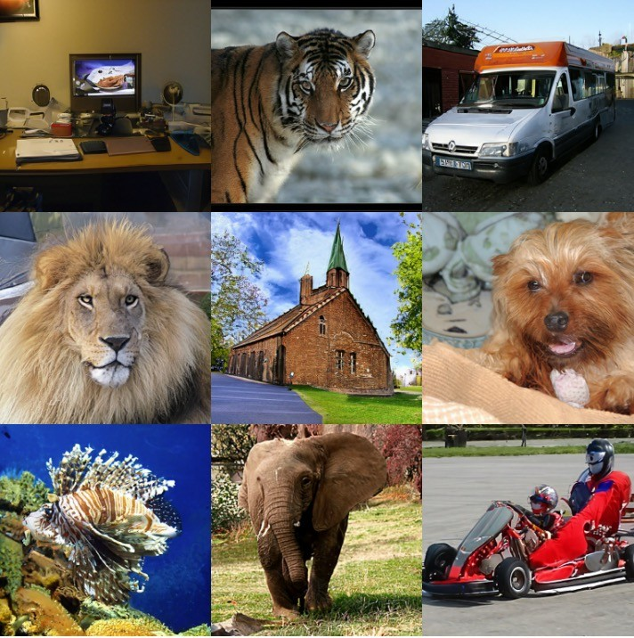
Denoising Diffusion Models
Emerging as powerful generative models, outperforming GANs
“Diffusion Models Beat GANs on Image Synthesis” Dhariwal & Nichol, OpenAI, 2021
“Cascaded Diffusion Models for High Fidelity Image Generation” Ho et al., Google, 2021
8

Slide 16
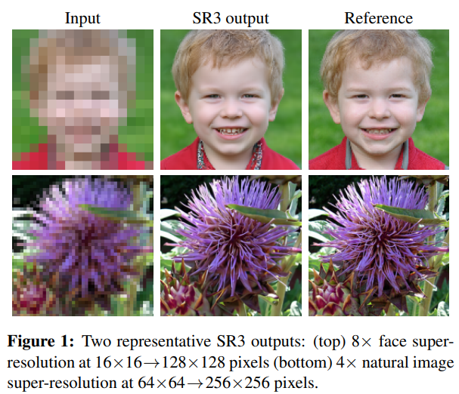
Image Super-resolution
Successful applications
Saharia et al., Image Super-Resolution via Iterative Refinement, ICCV 2021
16

Slide 17
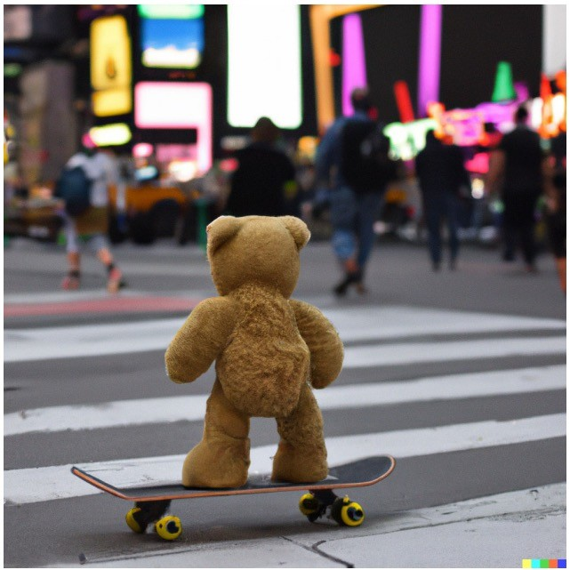
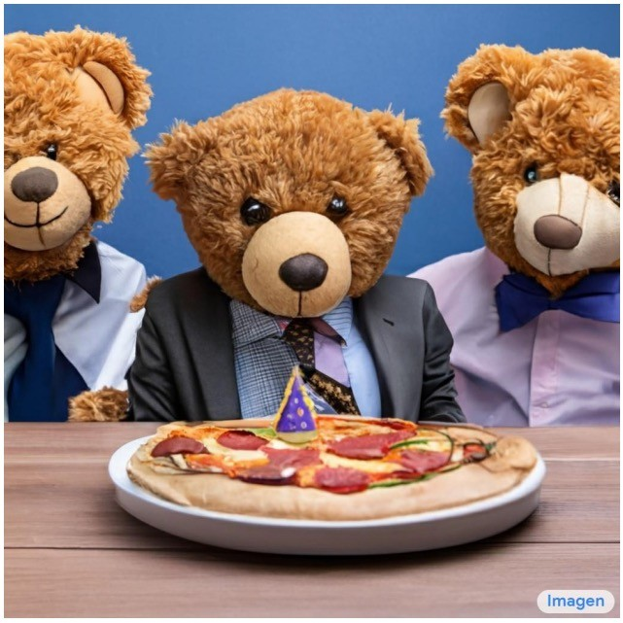
Text-to-Image Generation
DALL·E 2
Imagen
“a teddy bear on a skateboard in times square”
A group of teddy bears in suit in a corporate office celebrating the birthday of their friend. There is a pizza cake on the desk.
“Hierarchical Text-Conditional Image Generation with CLIP Latents” Ramesh et al., 2022
“Photorealistic Text-to-Image Diffusion Models with Deep Language Understanding”, Saharia et al., 2022
17

Slide 18
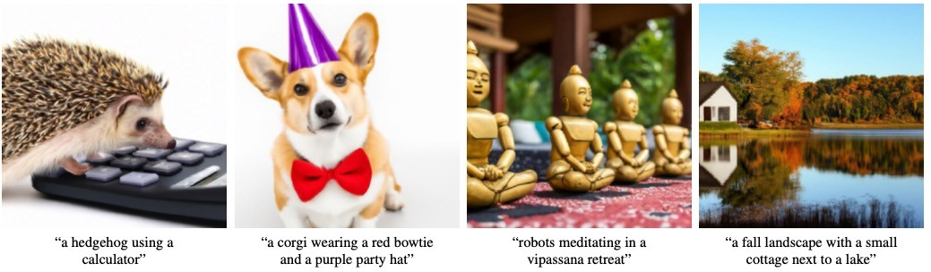
GLIDE
OpenAI
A 64x64 base model + a 64x64 → 256x256 super-resolution model.
Tried classifier-free and CLIP guidance. Classifier-free guidance works better than CLIP guidance.
Samples generated with classifier-free guidance (256x256)
Nichol et al., “GLIDE: Towards Photorealistic Image Generation and Editing with Text-Guided Diffusion Models”, 2021.

Slide 19
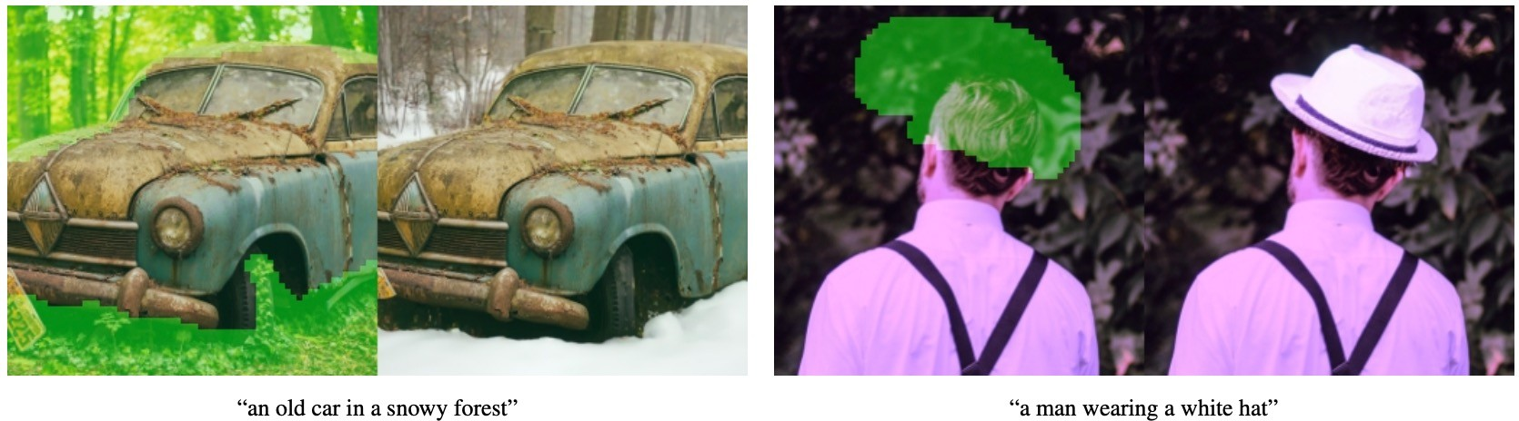
GLIDE
OpenAI
Fine-tune the model especially for inpainting: feed randomly occluded images with an additional mask channel as the input.
Text-conditional image inpainting examples
Nichol et al., “GLIDE: Towards Photorealistic Image Generation and Editing with Text-Guided Diffusion Models”, 2021.

Slide 20
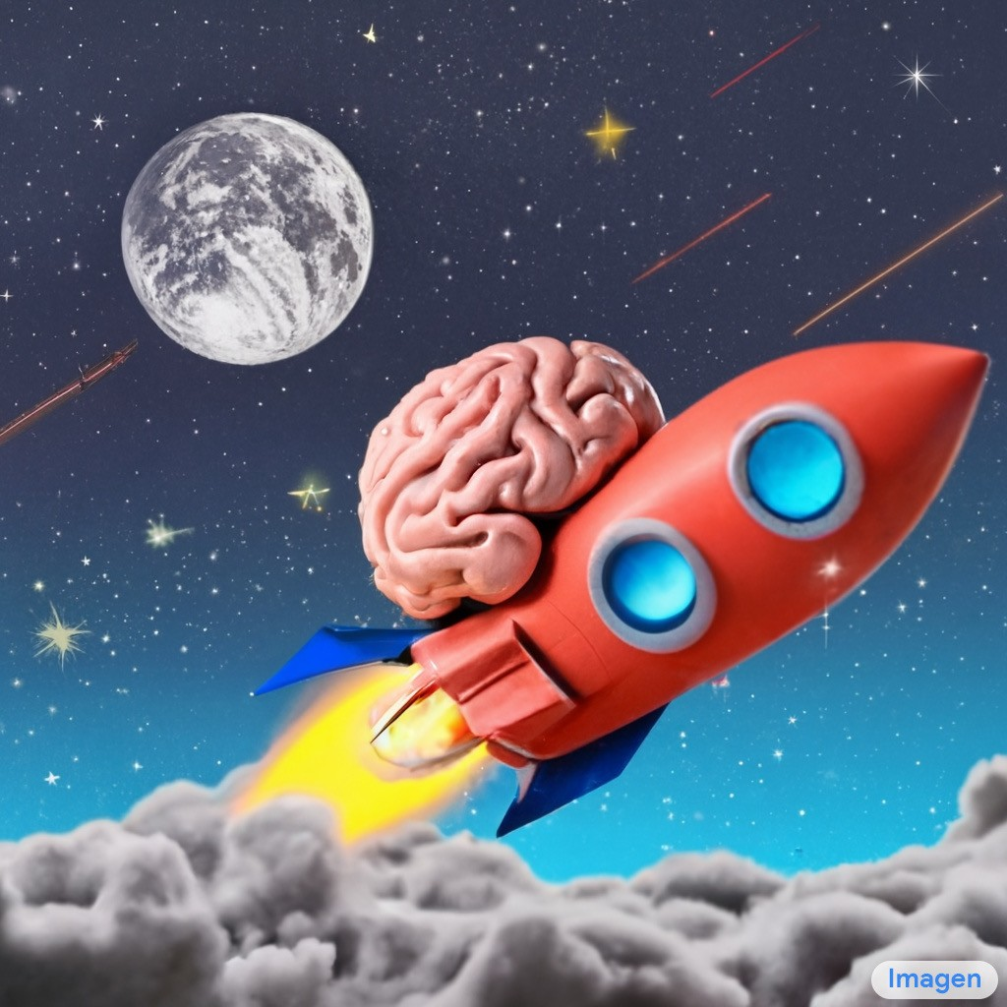
Imagen
Google Research, Brain team
Input: text;
Output: 1kx1k images
An unprecedented degree of photorealism
SOTA automatic scores & human ratings
A deep level of language understanding
Extremely simple
no latent space, no quantization
A brain riding a rocketship heading towards the moon.
Saharia et al., “Photorealistic Text-to-Image Diffusion Models with Deep Language Understanding”, arXiv 2022.

Slide 21
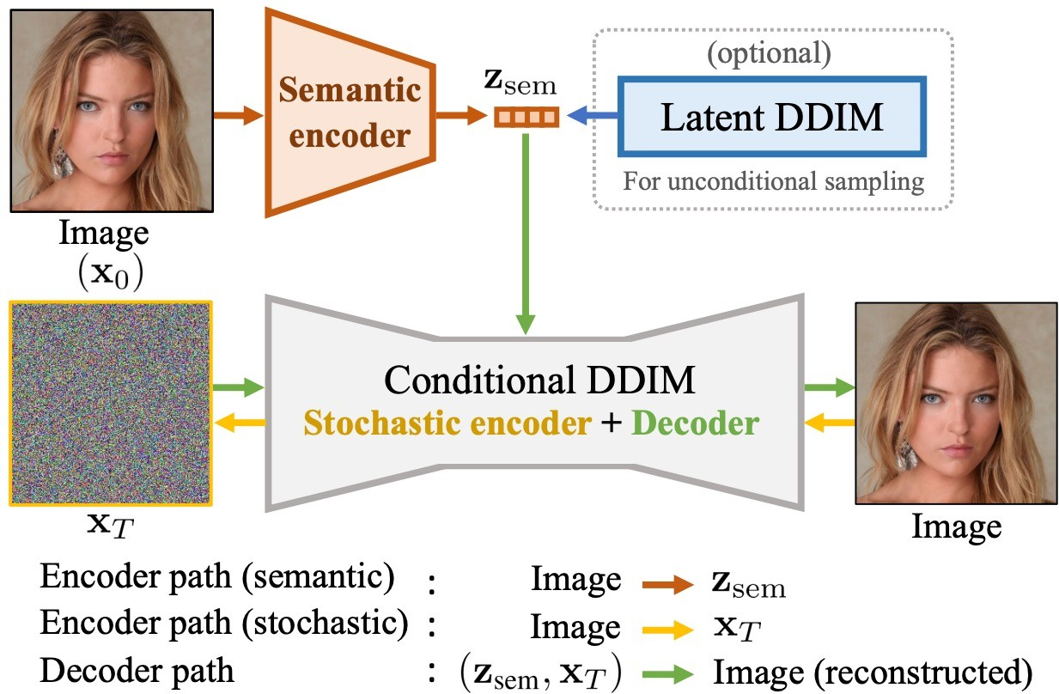
Diffusion Autoencoders
Learning semantic meaningful latent representations in diffusion models
Preechakul et al., “Diffusion Autoencoders: Toward a Meaningful and Decodable Representation”, CVPR 2022.

Slide 22
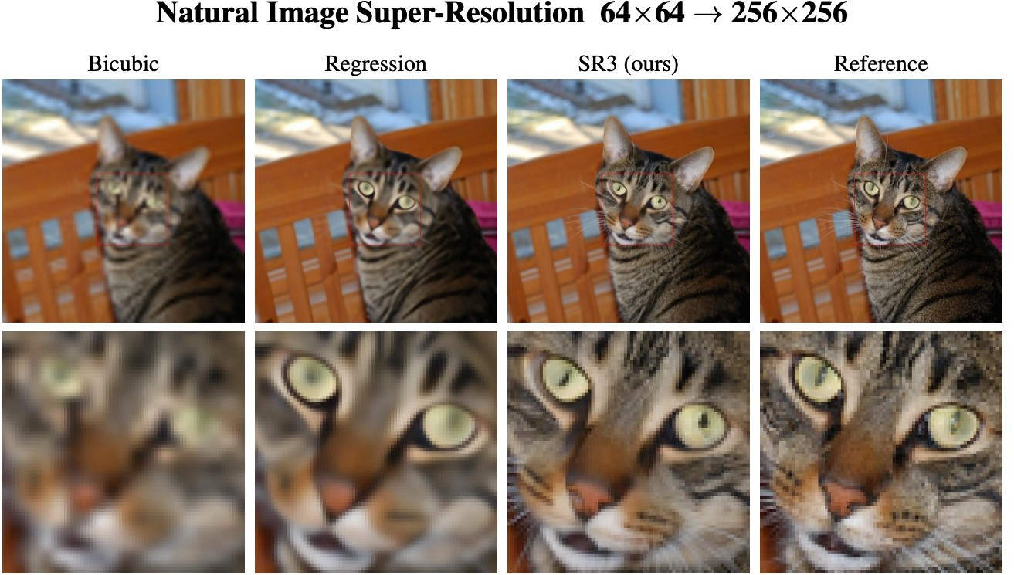
Super-Resolution
Super-Resolution via Repeated Refinement (SR3)
Saharia et al., Image Super-Resolution via Iterative Refinement, 2021

Slide 23
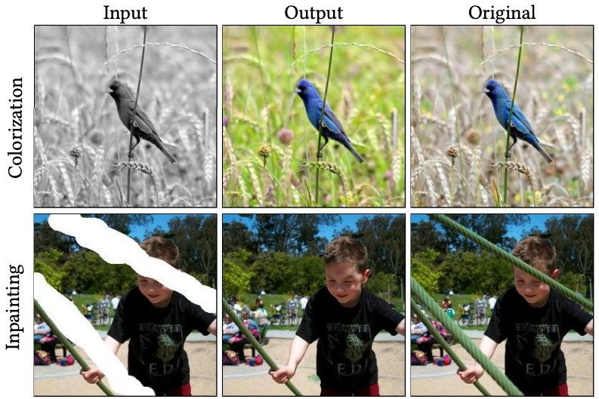
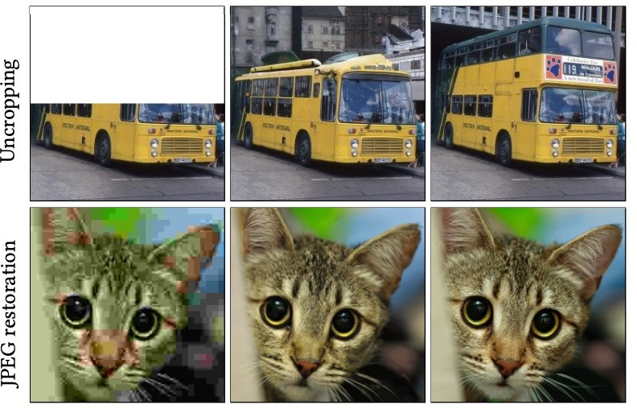
Image-to-Image Translation
Palette: Image-to-Image Diffusion Models
Saharia et al., Palette: Image-to-Image Diffusion Models, 2022

Slide 24
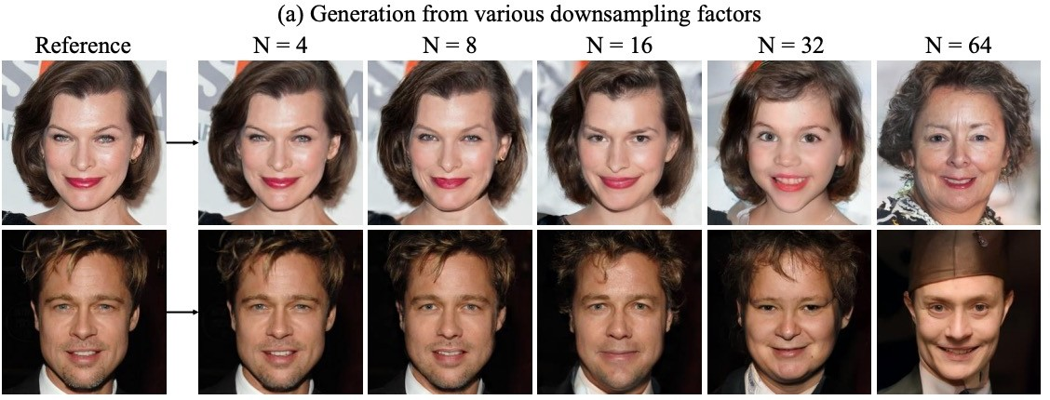
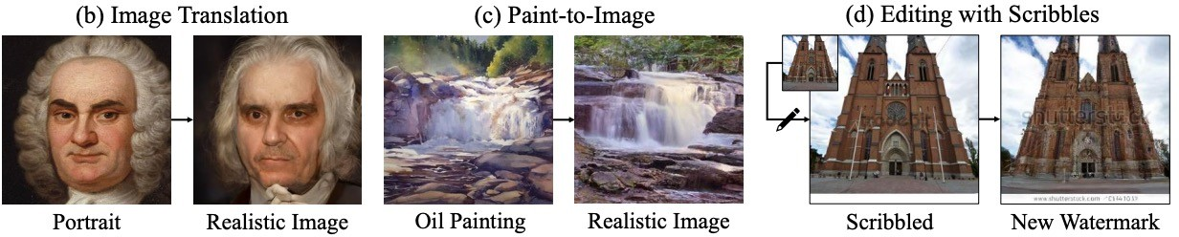
Conditional Generation
Iterative Latent Variable Refinement (ILVR)
Choi et al., ILVR: Conditioning Method for Denoising Diffusion Probabilistic Models, ICCV 2021

Slide 25
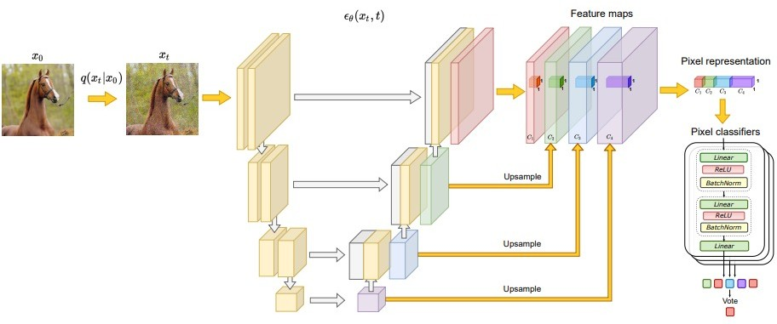
Semantic Segmentation
Label-efficient semantic segmentation with diffusion models
Can we use representation learned from diffusion models for downstream applications such as semantic segmentation?
Baranchuk et al., Label-Efficient Semantic Segmentation with Diffusion Models, ICLR 2022

Slide 26
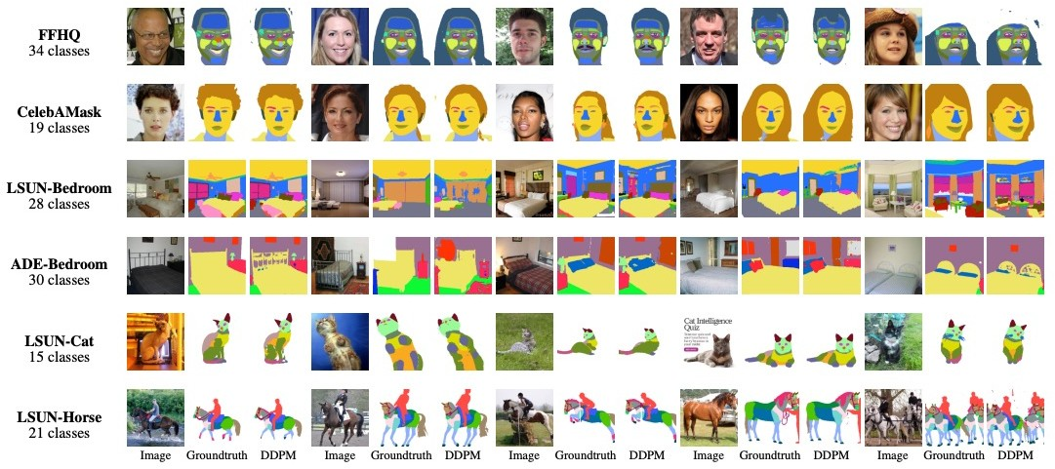
Semantic Segmentation
Label-efficient semantic segmentation with diffusion models
The experimental results show that the proposed method outperforms Masked Autoencoders, GAN and VAE-based models.
Baranchuk et al., Label-Efficient Semantic Segmentation with Diffusion Models, ICLR 2022

Slide 27
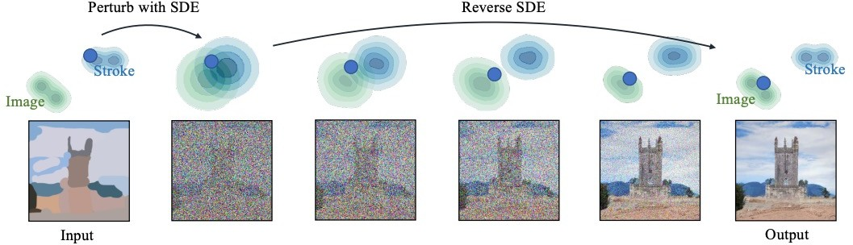
Image Editing
SDEdit
Forward diffusion brings two distributions close to each other
Meng et al., SDEdit: Guided Image Synthesis and Editing with Stochastic Differential Equations, ICLR 2022

Slide 28
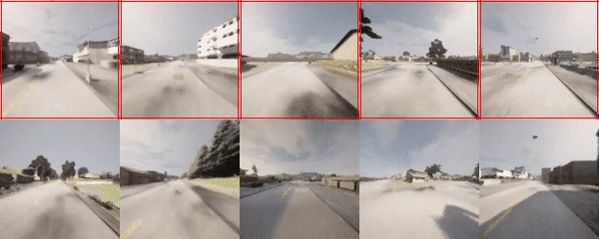
Video Generation
Results
Long term video generation in hierarchical manner:
1. Generate future frames in sparse manner, conditioning on frames far back
2. Interpolate in-between frames
Test Data:
1+ hour coherent video generation possible!
Generated:
Ho et al., “Video Diffusion Models”, arXiv, 2022
Harvey et al., “Flexible Diffusion Modeling of Long Videos”, arXiv, 2022
Yang et al., “Diffusion Probabilistic Modeling for Video Generation”, arXiv, 2022 Höppe et al., “Diffusion Models for Video Prediction and Infilling”, arXiv, 2022
Voleti et al., “MCVD: Masked Conditional Video Diffusion for Prediction, Generation, and Interpolation”, arXiv, 2022
(video from: Harvey et al., “Flexible Diffusion Modeling of Long Videos”, arXiv, 2022, https://plai.cs.ubc.ca/2022/05/20/flexible-diffusion-modeling-of-long-videos/)
170

Slide 29
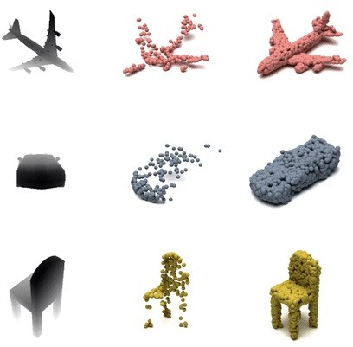
3D Shape Generation
Shape Completion
Can train conditional shape completion diffusion model (subset of points fixed to given conditioning points):
(video from: Zhou et al., “3D Shape Generation and Completion through Point-Voxel Diffusion”, ICCV, 2021, https://alexzhou907.github.io/pvd)
Zhou et al., “3D Shape Generation and Completion through Point-Voxel Diffusion”, ICCV, 2021

Slide 30
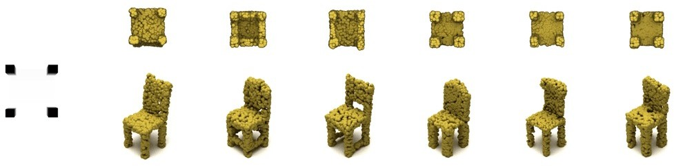
3D Shape Generation
Shape Completion – Multimodality
(video from: Zhou et al., “3D Shape Generation and Completion through Point-Voxel Diffusion”, ICCV, 2021, https://alexzhou907.github.io/pvd)
Zhou et al., “3D Shape Generation and Completion through Point-Voxel Diffusion”, ICCV, 2021

Slide 31
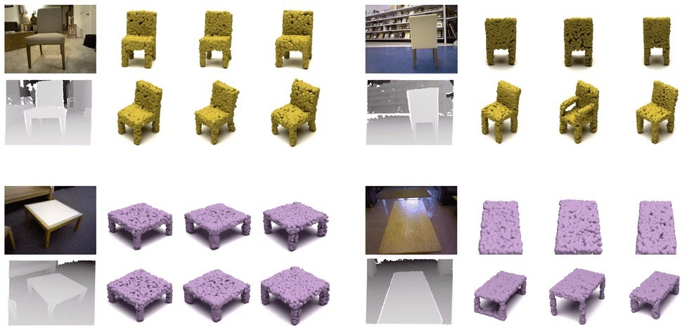
3D Shape Generation
Shape Completion – Multimodality – On Real Data
(video from: Zhou et al., “3D Shape Generation and Completion through Point-Voxel Diffusion”, ICCV, 2021, https://alexzhou907.github.io/pvd)
Zhou et al., “3D Shape Generation and Completion through Point-Voxel Diffusion”, ICCV, 2021

Slide 32
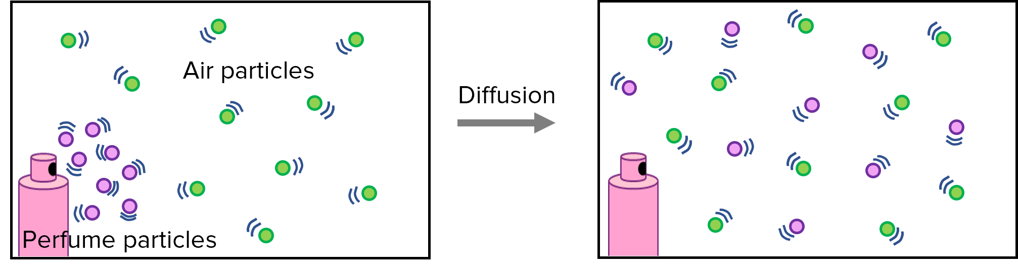
What is Diffusion?
Diffusion is the process of particles, information, or energy moving from an area of high concentration to an area of lower concentration.
This happens because systems tend to reach equilibrium
mmerevise.co.uk

Slide 33
What is a diffusion model?
Machine Learning: Diffusion refers to a specific approach for generating data using a stochastic process similar to a Markov chain.
Diffusion models create new data samples by starting with simple, easily generated data and gradually transforming it into more complex and realistic data.
Diffusion models are generative models
Generate new data based on the data they are trained on.
For example, a diffusion model trained on a collection of human faces can generate new and realistic human faces with various features and expressions.

Slide 34
Denoising Diffusion Probabilistic Models
Denoising diffusion models, also known as score-based generative models.
Recently emerged as a powerful class of generative models.
Demonstrate astonishing results in high-fidelity image generation
Often even outperforming generative adversarial networks.
This implies that denoising diffusion models are well suited for learning models of complex and diverse data.
Many Applications:
In computer vision for image editing, controllable, semantic, and text-driven image synthesis, image-to-image translation, super-resolution, image segmentation, as well as 3D shape generation and completion.
17

Slide 35
What is a diffusion model?
In the 2015 paper called “Deep Unsupervised Learning using Nonequilibrium Thermodynamics” introduced this.
Diffusion models are inspired by non-equilibrium thermodynamics.
They define a Markov chain of diffusion steps to slowly add random noise to data and then learn to reverse the diffusion process to construct desired data samples from the noise.
Unlike VAE or flow models, diffusion models are learned with a fixed procedure and the latent variable has high dimensionality (same as the original data).

Slide 36
What is a diffusion model?
Several diffusion-based generative models have been proposed with based on it.
Diffusion probabilistic models (Sohl-Dickstein et al., 2015)
Noise-conditioned score network (NCSN; Yang & Ermon, 2019)
Denoising diffusion probabilistic models (DDPM; Ho et al. 2020).

Slide 37
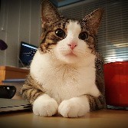
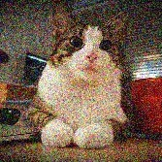
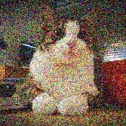
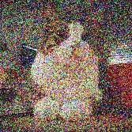
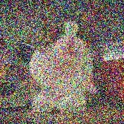
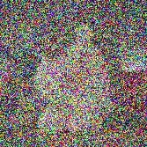
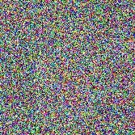
Denoising Diffusion Models
Denoising diffusion models consist of two processes:
Forward diffusion process that gradually adds noise to input
Reverse denoising process that learns to generate data by denoising Forward diffusion process (fixed)
Data
Noise
Reverse denoising process (generative)
Sohl-Dickstein et al., Deep Unsupervised Learning using Nonequilibrium Thermodynamics, ICML 2015 Ho et al., Denoising Diffusion Probabilistic Models, NeurIPS 2020
Song et al., Score-Based Generative Modeling through Stochastic Differential Equations, ICLR 2021
18

Slide 38
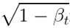
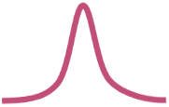
Forward Diffusion Process
The formal definition of the forward process in T steps:
Mean: Variance:
Can be a small value +ve
Forward diffusion process (fixed)
Data
Noise
x₀
x₁
x₂
x₃
x₄
…
x_{T}
19

Slide 39
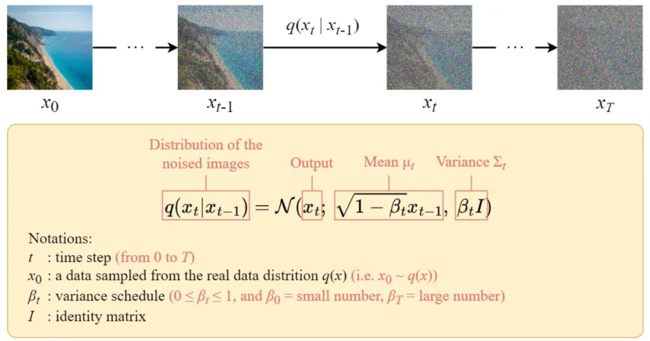
Forward Diffusion Process

Slide 40

Forward Diffusion Process
The formal definition of the forward process in T steps:
Mean: Variance:
Can be a small value +ve
Forward diffusion process (fixed)
Data
Noise
x₀
x₁
x₂
x₃
x₄
…
x_{T}
(joint)
19

Slide 41






Diffusion Kernel
Forward diffusion process (fixed)
Data
Noise
x₀
x₁
x₂
x₃
x₄
…
x_{T}
Define
For sampling: where
values schedule (i.e., the noise schedule) is designed such that
(Diffusion Kernel)
and
20

Slide 42
Diffusion Kernel
Refers to the mathematical formulation or function that describes how noise is incrementally added to the data across the diffusion process.
Plays vital role as it describes how data is transformed step-by-step from a meaningful signal into random noise.
This noise can then be converted to meaningful data through a reverse process.
The basic idea is to gradually transform data into a Gaussian noise distribution through a sequence of steps.
Modeled using a Markov process where each step is only dependent on the previous step.

Slide 43
Diffusion Kernel
Markov chain
It is a mathematical model that describes a sequence of possible events in which the probability of each event depends only on the state attained in the previous event.
This type of stochastic process is known as "memoryless" or having the "Markov property,"
The future state of the process is determined solely by the present state, not by how that state was reached.

Slide 44



Forward Diffusion
What happens to a distribution in the forward diffusion?
So far, we discussed the diffusion kernel
but what about
?
Diffused data dist.
Joint dist.
Input data dist.
Diffusion kernel
21

Slide 45




Forward Diffusion
So far, we discussed the diffusion kernel
but what about
?
Diffused Data Distributions
Data
Noise
x_{t}
Diffused data dist.
Joint dist.
Input data dist.
Diffusion kernel
The diffusion kernel is Gaussian convolution.
q(x₀)
q(x₁)
q(x₂)
q(x₃)
…
q(x_{T})
We do not have access to the x0 or intermediate distributions
We can sample
by first sampling
and then sampling
(i.e., ancestral sampling).
21

Slide 46

Forward Diffusion

Slide 47










Generative Learning by Denoising
Recall, that the diffusion parameters are designed such that
Diffused Data Distributions
Generation:
Sample
x_{t}
Iteratively sample
True Denoising Dist.
q(x₀)
q(x₀|x₁)
q(x₁)
q(x₂)
q(x₃)
…
q(x_{T})
q(x_{T-1}|x_{T})
In general,
is intractable.
q(x₁|x₂)
q(x₂|x₃)
q(x₃|x₄)
Can we approximate
? Yes, we can use a Normal distribution if
is small in each forward diffusion step.
22

Slide 48


Reverse Denoising Process
Formal definition of forward and reverse processes in T steps:
Reverse denoising process (generative)
Data
Noise
x₀
x₁
x₂
x₃
x₄
…
x_{T}
Trainable network
(U-net, Denoising Autoencoder)
23

Slide 49
References
Jascha Sohl-Dickstein et al. Deep Unsupervised Learning using Nonequilibrium Thermodynamics: arXiv:1503.03585v8
https://lilianweng.github.io/posts/2021-07-11-diffusion-models/
https:///posts/2021-07-11-diffusion-models
Tutorial on Denoising Diffusion-based Generative Modeling: Foundations and Applications by Arash Vahdat (Slides Credit)
Step by Step Visual Introduction to Diffusion Models by Kemal Erdem
Lecture by Peter Abbeel: https://www.youtube.com/watch?v=DsEDMjdxOv4

Slide 50
Thank You ☺

